Slide 1
GIS CLASS ASSIGNMENTS
By Stella Njeru

Slide 2
ASSIGNMENT 1: Kenya BTS Distribution in select regions(per technology)

Slide 3
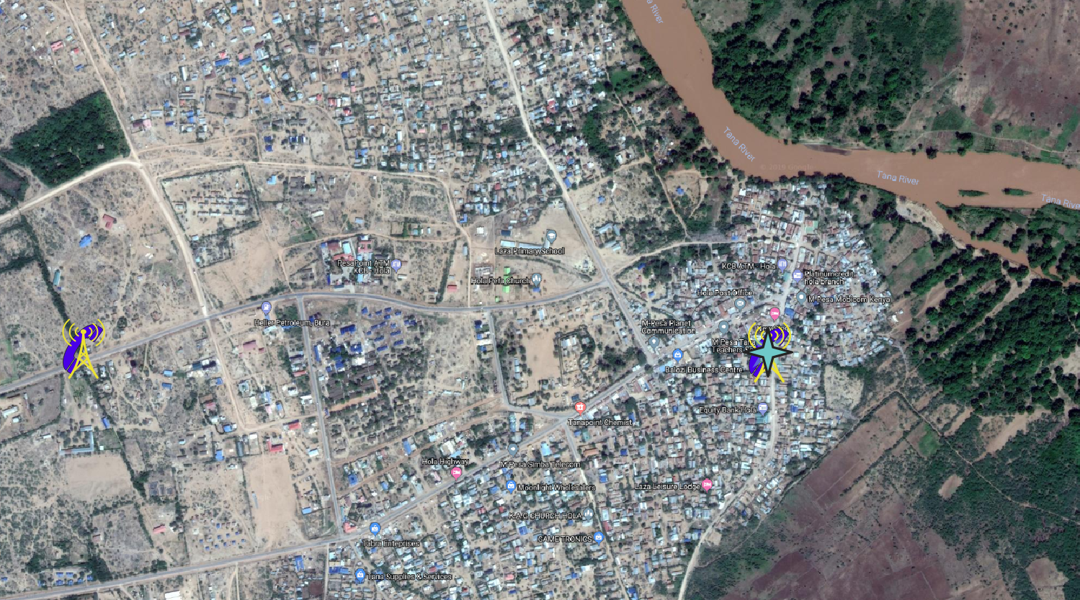
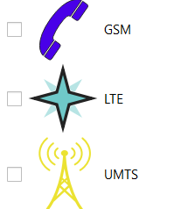
BTS Positioning in Bura, village, laza (Google satellite & Google roads)
The vector layers added to the map are:
Kenya Counties Shapefile
Google Satellite
Google Roads

Slide 4
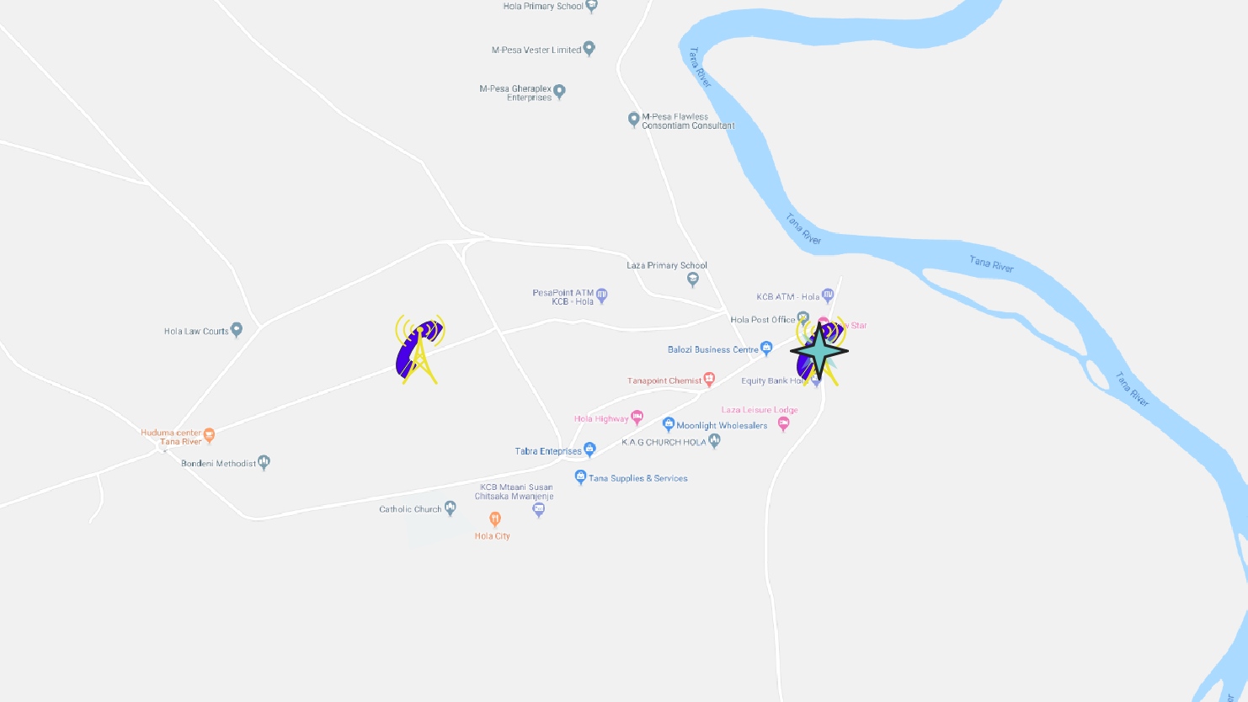
BTS Positioning in Bura, village, laza (Google STreet)
The vector layer added to the map is:
Google Street

Slide 5
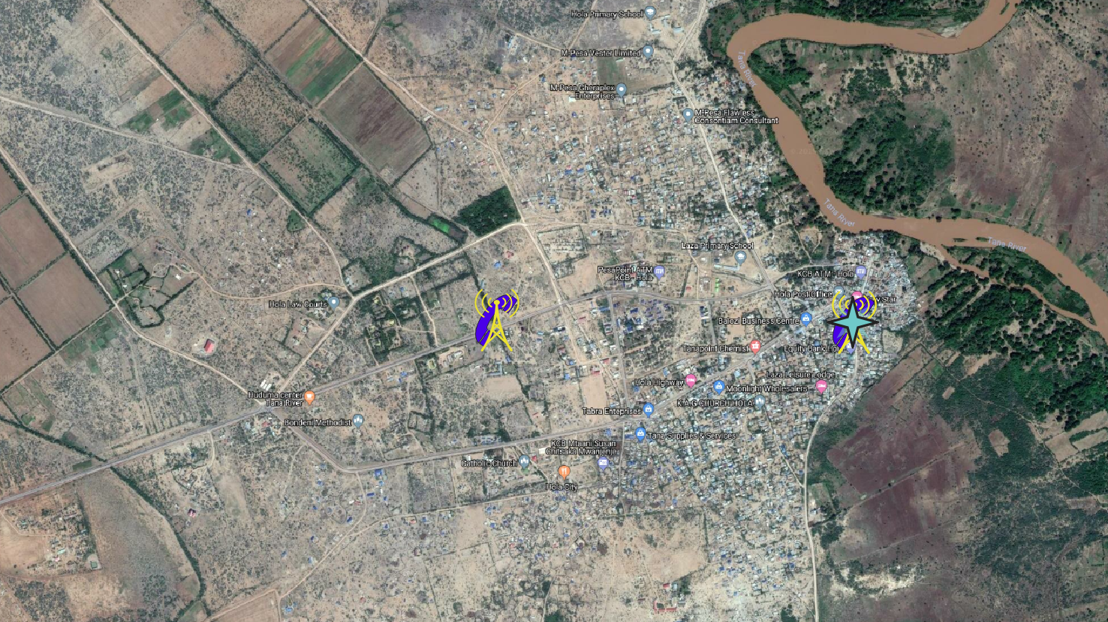
BTS Positioning in Bura, village, laza (Google HYBRID)
The vector layers added to the map are:
Google Hybrid

Slide 6
BTS Positioning in Bura, village, laza (Google HYBRID)
The vector layers added to the map are:
Google Hybrid

Slide 7
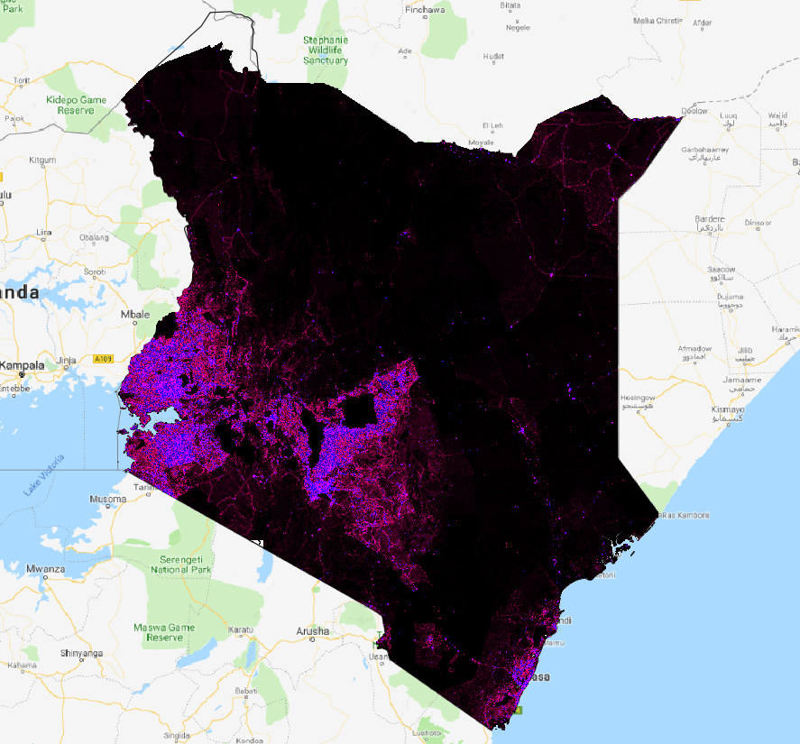
Population distribution

Slide 8
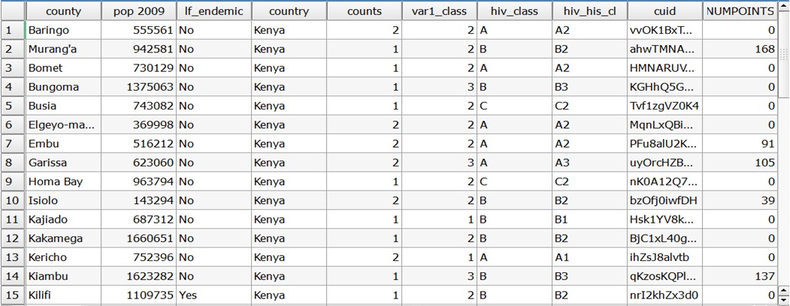
DISTRIBUTION OF BTS in counties

Slide 9
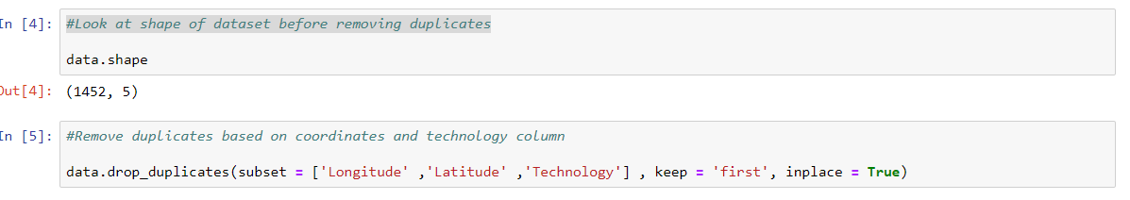
PYTHON CODE TO REMOVE DUPLICATES FROM BTS DATASET

Slide 10
ASSIGNMENT 2: TRAVEL FOR SERVICING FROM SAFARICOM NYERI OFFICE TO MANDERA VIA GARISSA AND WAJIR

Slide 11
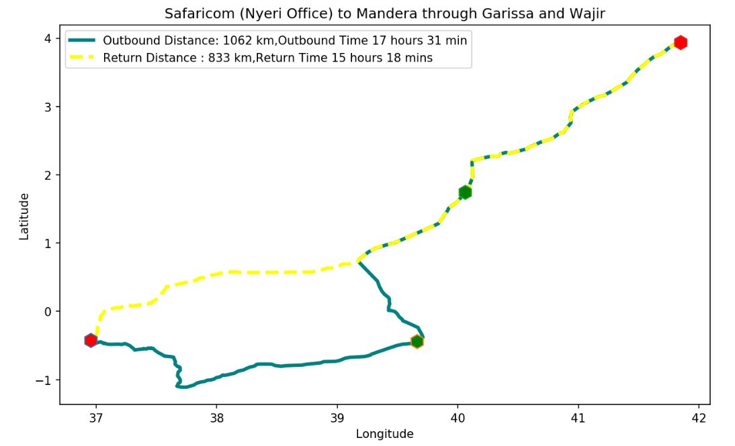
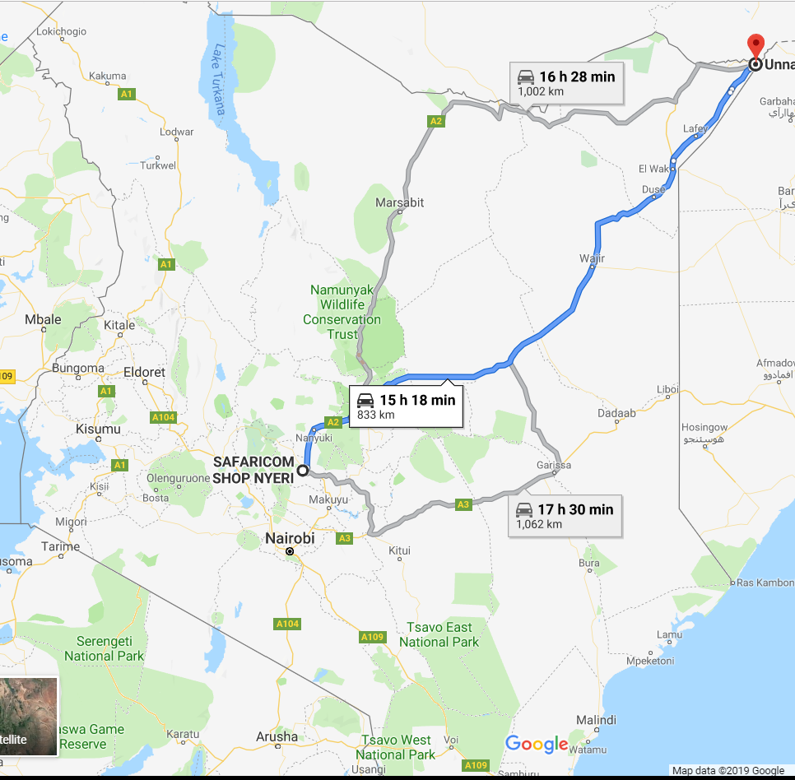
MATPOTLIB MAP SHOWING PROPOSED ROUTEs AGAINST GOOGLE MAP
Mandera Bula Tawakal BTS
Wajir_BullaMadina BTS
Safaricom Nyeri
Garissa_Bulla_Market BTS
MATPLOTLIB
GOOGLE MAPS

Slide 12
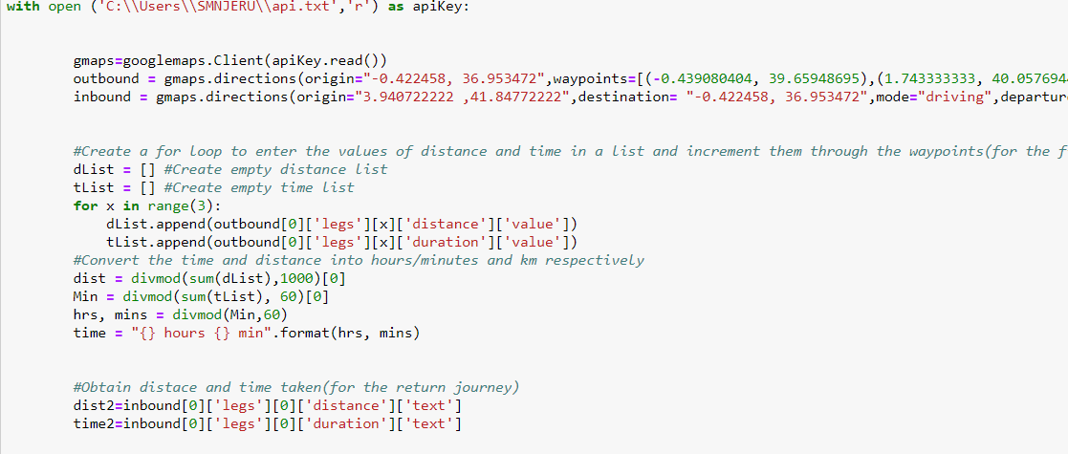
PYTHON CODE FOR ROUTE SELECTION

Slide 13
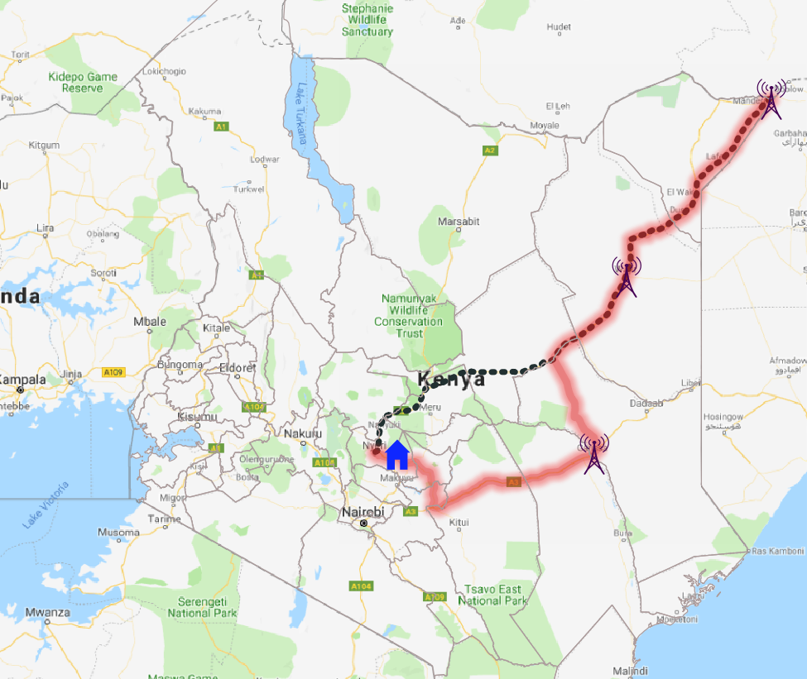
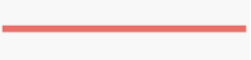


QGIS MAP SHOWING PROPOSED ROUTEs with google Roads basemap
Legend:
Return Route
Outbound Route
Safaricom Nyeri
BTS

Slide 14
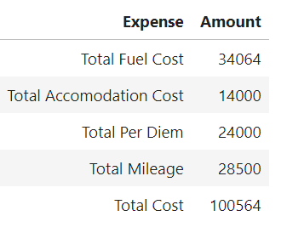
ROUTE PLAN & EXPENDITURE BREAKDOWN
Description of Journey
Travel from Nyeri to Garissa and test signal on site
Travel from Garissa to Wajir and test signal on site
Spend the night at Wajir.
Travel to Mandera site, perform drive test and drive back to Duse to spend the night
Drive back to Nyeri
NB:
Drive tests of 30 minutes per BTS Location
Driving breaks of 30 minutes after every 3 hours

Slide 15
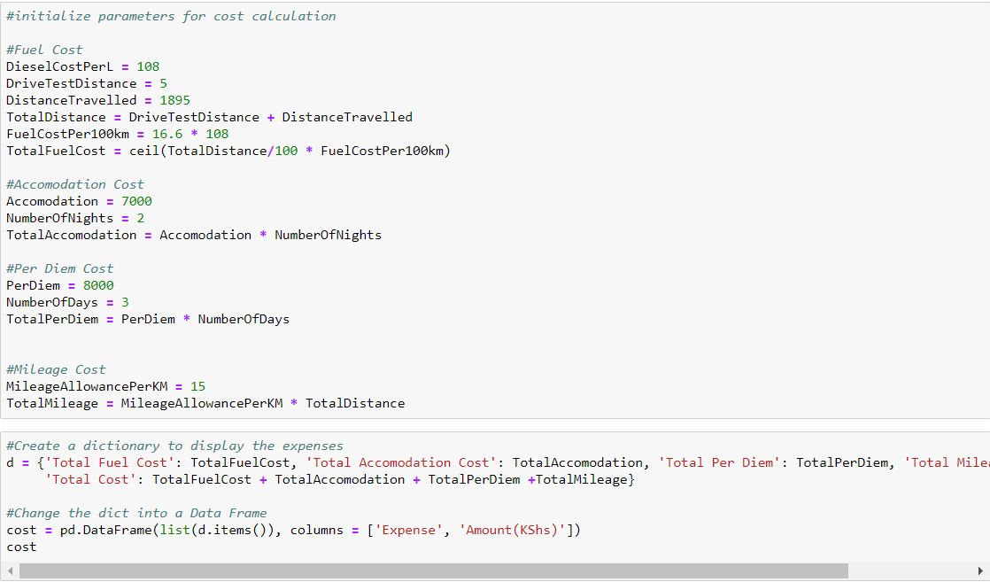
EXPENDITURE CODE

Slide 16
RECOMMENDATIOS TO REDUCE EXPENDITURE
Use a lower consumption car that can handle the rough terrain encountered.
Have field engineer of these locations do the drive tests.
Ask for discounted rates on accommodation locations.

Slide 17
ASSIGNMENT 3: Kenya BTS Distribution in select regions ON FOLIUM

Slide 18
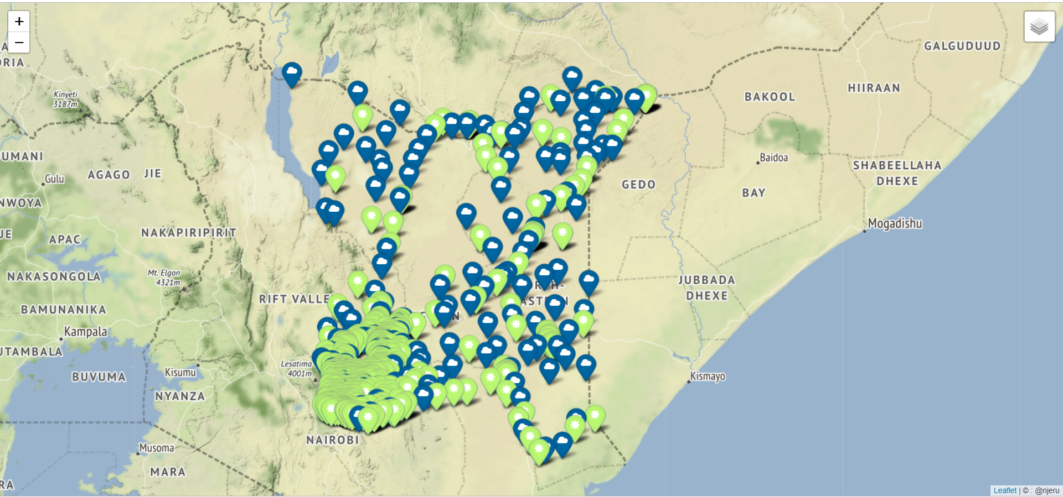
BTS DISTRIBUTION

Slide 19
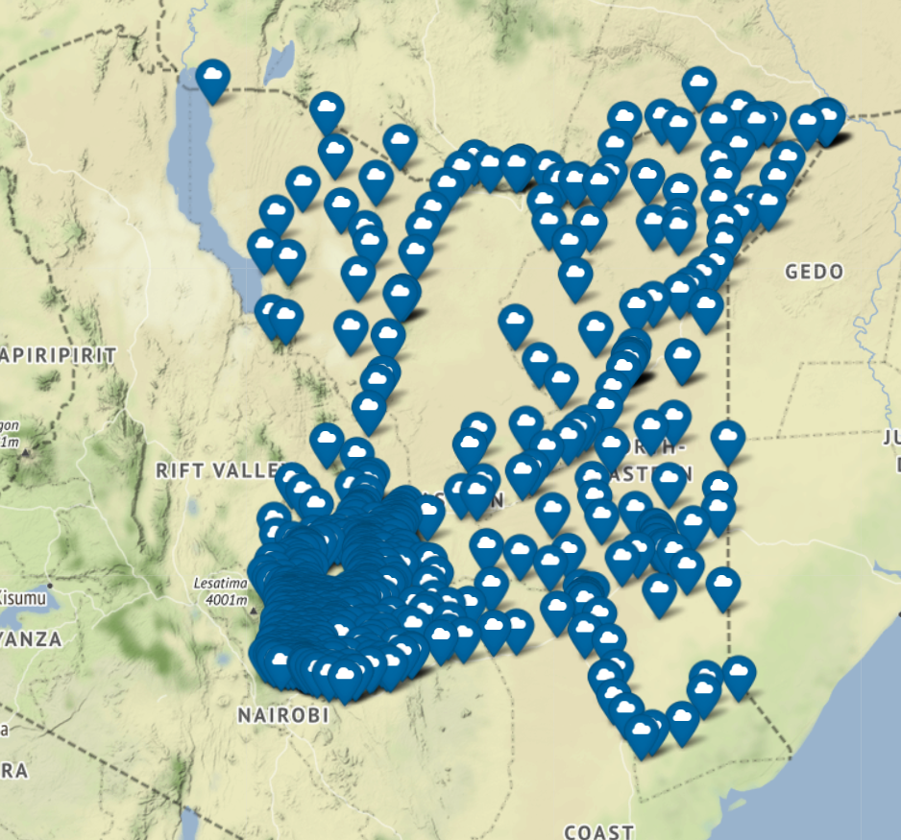
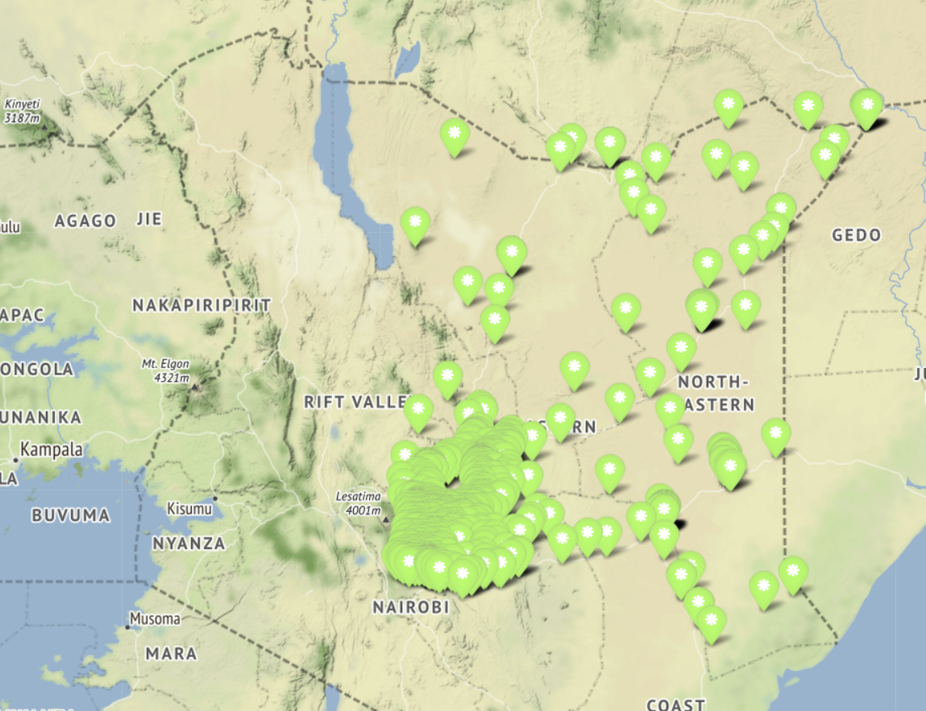
GSM Distribution UMTS Distribution

Slide 20
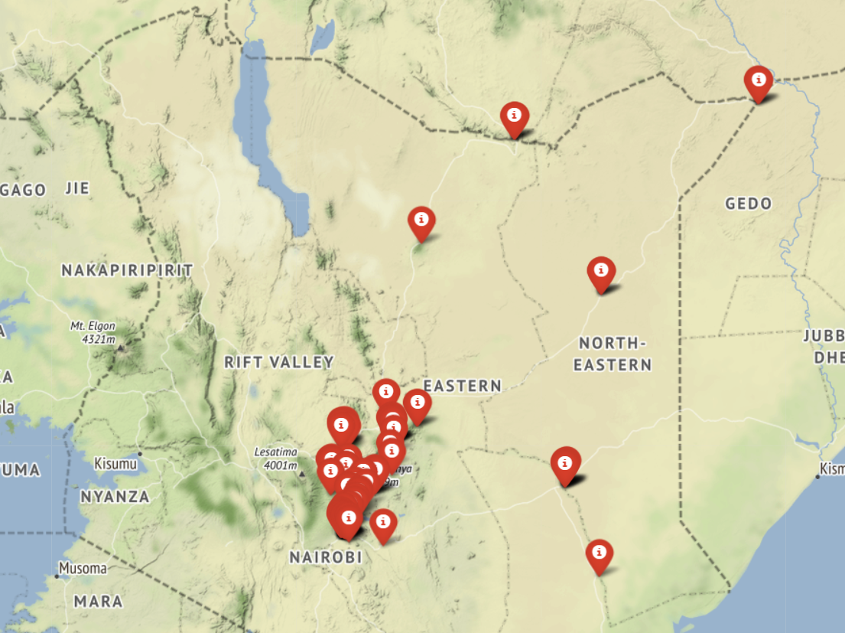
Lte distribution

Slide 21
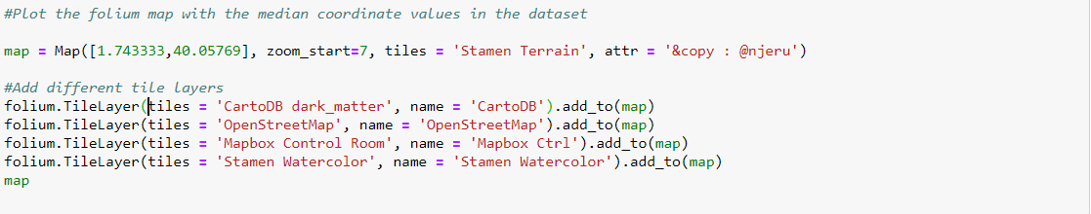
FOLIUM CODE

Slide 22
GIT REPO
https://github.com/smnjeru/GIS.git

